Slide 1

SECURE BANK TRANSACTIONS USING BLOCKCHAIN TECHNOLOGY
N.B.K.R. INSTITUTE OF SCIENCE AND TECHNOLOGY (AUTONOMOUS) VIDYANAGAR-524413, TIRUPATI DISTRICT.
ACADEMIC YEAR 2022-2023
UNDER THE GUIDANCE :
Mr. B.SHOWRI RAYALU
Coordinator:
Mr. S.SURESH BABU
A.M.SAI CHARITH 19KB1A0514
A.SARATH BABU 19KB1A0507
K.YASWANTH 19KB1A0564
V.LOKESH 20KB5A0501

Slide 2
Table Of Contents:
Abstract
Motivation
Problem Statement
Objectives
Literature Survey
Methodologies
Implementation
Result Analysis
Conclusion and Future Enhancements

Slide 3
Abstract
Blockchain is a distributed database or a decentralized ledger which is most commonly used to exchange digital currency and perform transactions securely. Every participant of the network has access to the ledger which will be updated by every new transaction. The blockchain ledger is a collection of all transactions executed in the past. The blockchain ledger is a continuously growing tamper-proof data structure containing blocks that hold batches of individual transactions. The completed blocks are added in chronological order. In this paper, we propose an alternative proof-by-approval protocol which is A more advanced form of the proof-of-reputation protocol, that offers better security and is A more decentralized approach than the former at the cost of being less performant and harder to setup.

Slide 4
Motivation
The motivation for secure bank transactions using blockchain is to create a more secure efficient and cost effective solutions for industrial banking. The traditional banking system is plagued by number of challenges ,including slow transactions speed, high cost, lack of transparency, and inadequate security measures.
By leveraging the power of blockchain technology, banks and other financial institutions can overcome these challenges and provide a more secure and efficient solution for their customers. With blockchain, transactions are processed much faster as there is no need for intermediaries to verify them. This not only saves time, but also reduces costs as intermediaries are eliminated.

Slide 5
Problem Statement
The Indian banking industry today is faced with issues such as rising costs of operations, increasing susceptibility to fraudulent attacks on centralized servers and challenges in ensuring transparency. All this, primarily because most of the banking transactions may require intensive manual processing and documentation, involve costly intermediaries and are time consuming as these transactions need to be validated by various participants at various point in time causing the delay thereby resulting in almost lack of fraud proof real time solution.

Slide 6
Objectives
The main objective of using blockchain for secure bank transactions is to provide a secure, transparent, and decentralized ledger for recording and verifying financial transactions. Blockchain technology offers several benefits such as immutability, improved security through encryption, and the elimination of intermediaries, which reduces the risk of fraud and ensures that transactions are executed with accuracy and efficiency.
By using blockchain, banks aim to increase transparency, reduce transaction costs, improve security and accountability, and enhance customer experience.

Slide 7
Literature Survey
PAPER NAME AND AUTHOR | PUBLISHED /YEAR | PURPOSE
Blockchain application and outlook in the banking industry, Ye Guo and Chen Liang | 2016 | In this paper,Blockchains could revolutionize the underlying technology of the payment clearing and credit information systems in banks, thus upgrading and transforming them.
Blockchain Technology and the Financial Services Market, Krause et al. | 2017 | The technology could remove trusted third parties, decrease costs and ultimately increase profits for various players within the industry.

Slide 8
Literature Survey
Block Chain & Financial Inclusion,Prof. Reena Aggrawal | 2017 | This paper discussed that blockchain can play significant role in the financial Inclusion process. It says that F.I. using blockchain for internal and cross border payments can lower costs, shorten settlement time, and provide better user experience.
Blockchain in banking, Deloitte | 2017 | As transaction are being done up on Blockchain, Blockchain DLT and all the relevant parties can view and verify the processes. There is only one source of truth and transactions cannot be processed further unless all the relevant parties agree and authenticate it.

Slide 9
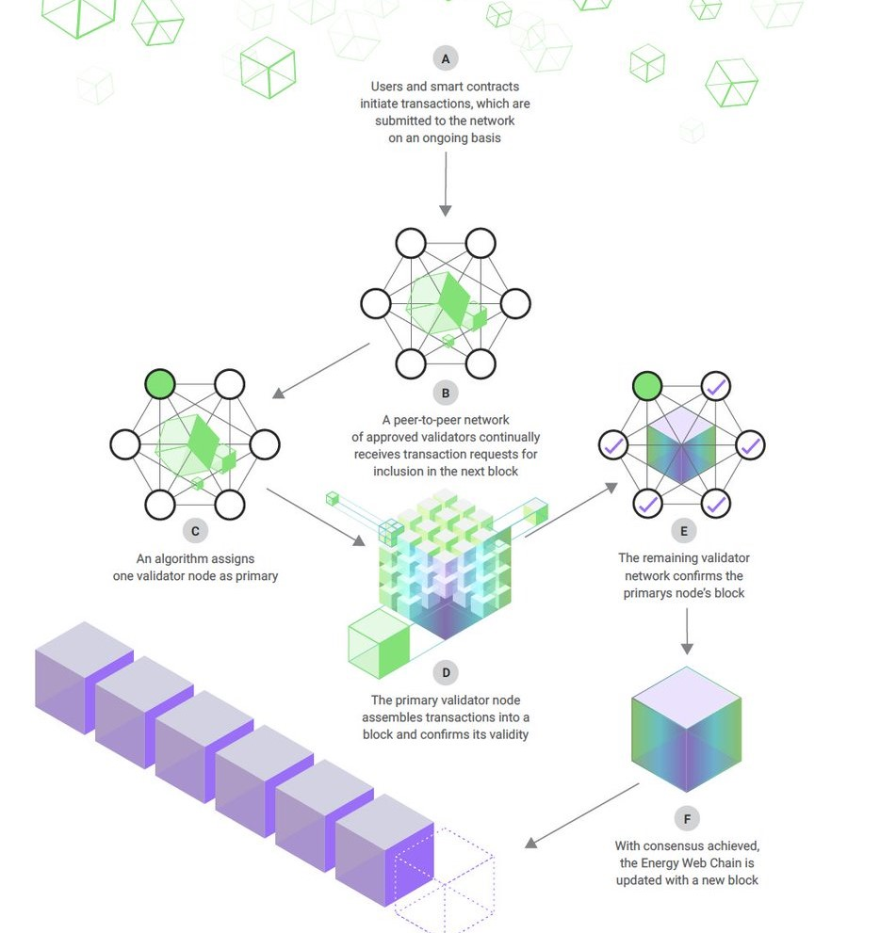
Methodology

Slide 10
Implementation
This project aims to propose a Blockchain-based alternative to Google Pay, a bank-to- bank payments software developed by Google. The key purpose of the article is to develop a web application that would allow transactions between centralized systems to be made through a decentralized network.
In order to conduct a transaction, a user must first produce a block including all relevant information, as explained in the protocol's workings above. Just the user's username will be accessible to anybody who has a copy of the blockchain.
The user would separately provide his or her personal information to their bank (via KYC, for instance) and send it to the bank where their account is located.

Slide 11
Result Analysis
Login Test Analysis: Verify that the user can successfully login to the system with valid credentials. Verify that the user is unable to login with invalid credentials.
Account Creation Test Analysis: Verify that the user can successfully create a new account. Verify that the user is unable to create a new account with incomplete or incorrect information.
Deposit and Withdrawal Test Analysis: Verify that the user can successfully deposit and withdraw money from their account. Verify that the user is unable to withdraw more money than they have in their account.
Transfer Funds Test Analysis: Verify that the user can successfully transfer funds to another account. Verify that the user is unable to transfer more money than they have in their account.
Blockchain Ledger Test Analysis: Verify that all transactions are recorded on the blockchain ledger.

Slide 12
Conclusion and Future Enhancements
In conclusion, secure bank transactions using blockchain technology provides a number of benefits such as enhanced security, faster transaction processing times, reduced transaction costs, and improved transparency. By leveraging the distributed ledger technology, banks can improve their operations and enhance their customer experience.
To enhance the secure bank transactions using blockchain, future developments could include:
Integration with other blockchain networks to improve interoperability and allow for seamless transaction processing.
Development of smart contracts to automate and streamline transaction processing, which could reduce transaction costs and improve processing times.

Slide 13
Thank you

